Slide 1

MockMate AI
Group members:
ALTAMASH CHOUGLE - 5
ATHARVA HARANE - 15
DARSH KAMBLE - 23
SNEHA SINGH - 64
Guide: Dr. A. R. Sonule

Slide 2
Outline
Introduction
Literature Survey
Research Gap
Problem Statement
Objectives
Proposed System
Design
Future Work
References

Slide 3
Introduction
MockMate AI is an AI-powered web-based platform designed to assist students in preparing effectively for campus placements.
This platform provides a voice-interactive, end-to-end preparation environment that simulates the actual placement experience.
The system uses voice-based interaction to create a realistic, hands-on experience.

Slide 4

Scope of the Project
Customizable for company type, domain & tech stack.
Simulates complete placement process (Aptitude to HR).
AI-driven technical & HR interview mock sessions.
Real-time feedback & performance analytics.
In-browser code editor with collaboration features.
User login, session tracking & progress reports.

Slide 5
Literature Survey
Sr. No | Paper Title | Author(s) | Publisher/Conference | Year | Algorithm Used | Pros | Cons | Results/ Output
1 | AI-Based Interview Mocker System | Lokesh Jagtap, Suyash Rane, Rahul Dhonnar, Jyoti Pawar, Umesh Bhadane. | IJARSCT | 2025 | LLM + NLP + Vision (eye contact, posture) | Personalized question sessions, real-time feedback, performance analytics | Require high computation resources and high speed internet | Dashboard-based session metrics, NLP & vision feedback integration
2 | Adaptive Interview Strategy for Robots | Fuminori Nagasawa, Shogo Okada, Katsumi Nitta, Takuya Ishihara. | IEEE | 2024 | Engagement-based adaptive question tree, multimodal sensing | Adaptive questioning, confidence/ hesitation detection | Complexity in implementing real-time multimodal sensing | Personalized real-time adjustment during interaction
3 | Fairness-Aware Multimodal Learning | Changwoo Kim, Woojin Lee, Jinho Choi, Daehun Yoo, Jongyeon Yoon. | IEEE | 2023 | Audio + video fusion, adversarial training | Demographic fairness, multimodal scoring | Trade-off between accuracy and fairness | Advanced fairness-aware scoring analytics
4 | TensorFlow-Based Automatic Personality Recognition | Hung-Yue Suen, Kuo-en Hung, Chien-Liang Lin. | IEEE | 2019 | CNN + Big-Five Personality Prediction | Personality-based feedback, self-improving model | Requires labeled training data and iterative learning | Tailored question flow based on predicted traits

Slide 6
AI-Based Interview Mocker System
Authors: Lokesh Jagtap, Suyash Rane, Rahul Dhonnar, Jyoti Pawar,Umesh Bhadane.
Publisher: IJARSCT
Algorithms used: LLMs, NLP feedback, Computer Vision
Pros: Personalized questions, real-time feedback, analytic dashboard
Cons: High computation, needs stable internet
Results: Dynamic mock interviews with performance tracking

Slide 7
Adaptive Interview Strategy for Robots
Authors: Fuminori Nagasawa, Shogo Okada, Katsumi Nitta, Takuya Ishihara.
Publisher: IEEE
Algorithms used: Multimodal sensing, engagement-driven tree
Pros: Adaptive flow, detects confidence/hesitation
Cons: Complex real-time sensing integration
Results: Real-time adjustment based on user engagement

Slide 8
Fairness-Aware Multimodal Learning
Authors: Changwoo Kim, Woojin Lee, Jinho Choi, Daehun Yoo, Jongyeon Yoon.
Publisher: IEEE
Algorithms used: Audio-video fusion, adversarial training
Pros: Fairness, joint optimization, unbiased scoring
Cons: Trade-off with accuracy
Results: Demographic-fair scoring system

Slide 9
TensorFlow-Based Automatic Personality Recognition
Authors: Hung-Yue Suen, Kuo-en Hung, Chien-Liang Lin.
Publisher: IEEE
Algorithms used: CNN, Big-Five prediction, self-training loop
Pros: Personality-based feedback, adaptive questioning
Cons: Needs labeled data, retraining for context
Results: Tailored sessions based on inferred traits

Slide 10
Research Gap
No unified platform simulates the full placement process (aptitude → coding → technical → HR).
Existing systems lack end-to-end personalization across all interview stages.
Minimal use of AI voice assistants for realistic, dynamic interview interactions.
No support for collaborative learning (e.g., peer code sharing or competitions).
Feedback loops are fragmented – rarely combining NLP, coding, and behavioral analysis.

Slide 11
Problem Statement
"To bridge the gap between students’ knowledge and their performance in real-world campus placement interviews by providing an AI-powered, voice-interactive mock placement simulator with personalized guidance and feedback."

Slide 12
Objectives
Provide a guided, end-to-end mock placement experience.
Leverage AI (voice & LLM) for personalized question sessions.
Offer real-time feedback and performance analytic
Enable collaborative practice through shareable coding challenges

Slide 13
Proposed System
A complete mock placement simulator covering Aptitude, Coding, Technical, and HR interview rounds.
AI-powered voice assistant generates personalized questions based on domain, target company, and skills
Real-time feedback on spoken and written responses, including grammar, confidence, and content quality.
Performance analytic dashboard provides strengths, improvement areas, and suggested model answers.
Enables collaborative learning through shareable coding challenges and peer practice sessions.

Slide 14
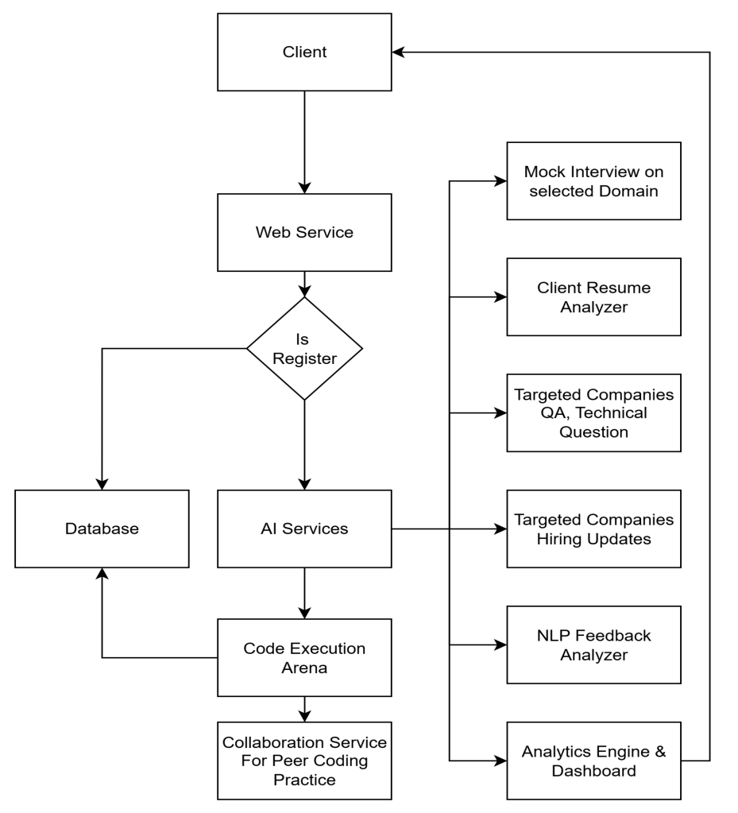
System Architecture / Flowchart

Slide 15
CO PO PSO Mapping
 | PO1 | PO2 | PO3 | PO4 | PO5 | PO6 | PO7 | PO8 | PO9 | PO10 | PO11 | PO12 | PSO1 | PSO2
CO1 | 1 | 2 |  |  |  |  |  |  |  |  |  |  | 1
CO2 | 1 | 2 | 3 |  |  |  |  |  |  |  |  |  | 1 | 2
CO3 | 1 | 2 | 3 |  |  |  |  | 1 | 2 |  |  |  |  | 2
CO4 | 2 | 2 |  | 3 |  |  |  |  |  |  |  |  |  | 2
CO5 |  | 2 | 3 |  | 3 | 3 |  |  |  |  |  |  |  | 2
CO6 |  | 2 | 3 |  | 2 |  |  | 2 |  |  |  |  | 1 | 1
CO7 |  |  |  |  | 3 |  | 3 | 2 |  | 1 |  |  |  | 2
CO8 | 2 | 2 |  |  |  |  |  |  | 3 |  | 2 | 3 | 2 | 2
CO9 |  |  |  |  |  |  |  |  | 3 |  | 3 |  |  | 1

Slide 16
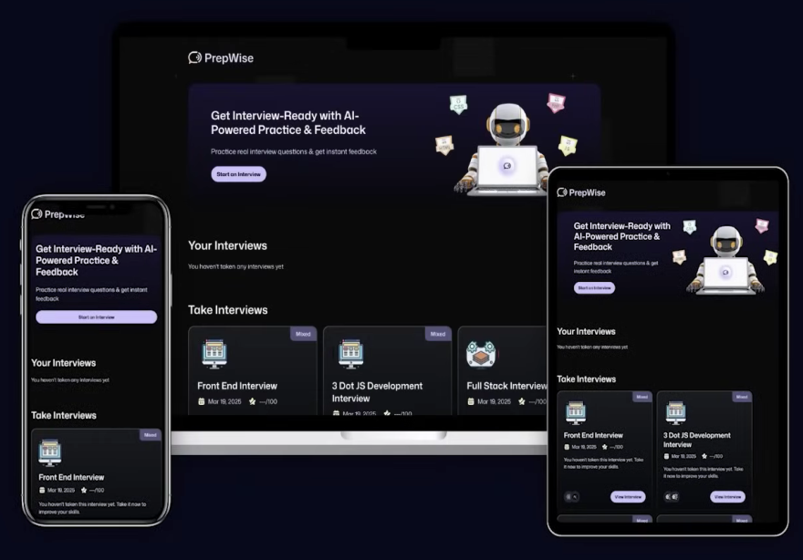
Design

Slide 17
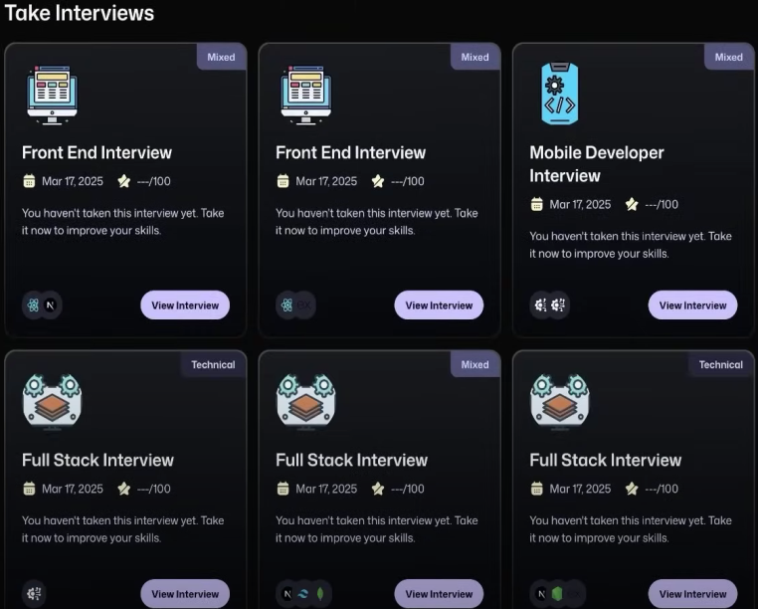

Slide 18
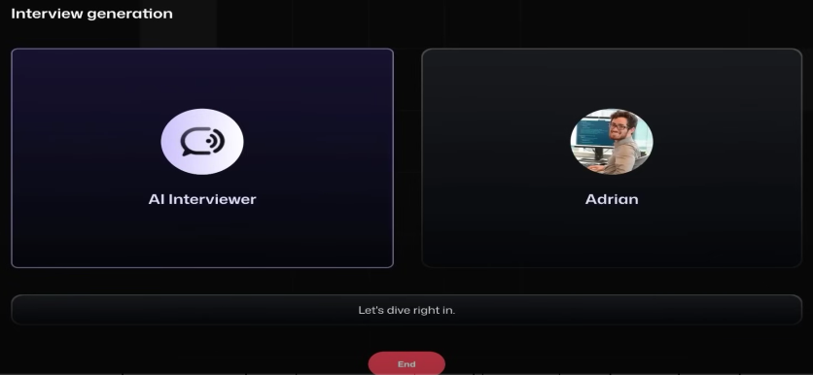

Slide 19
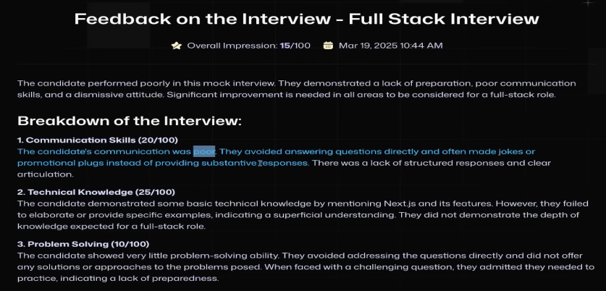

Slide 20
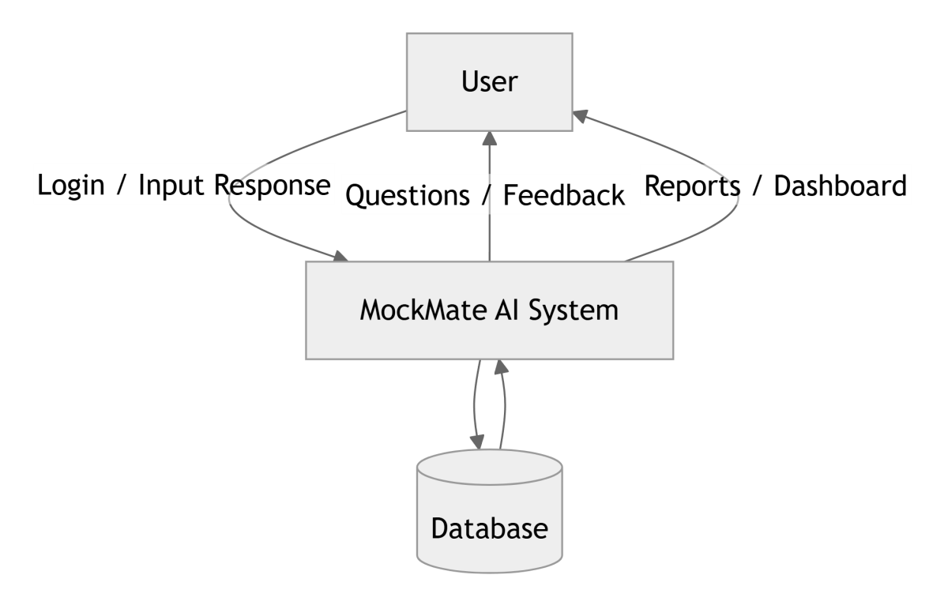
DFD Level 0

Slide 21
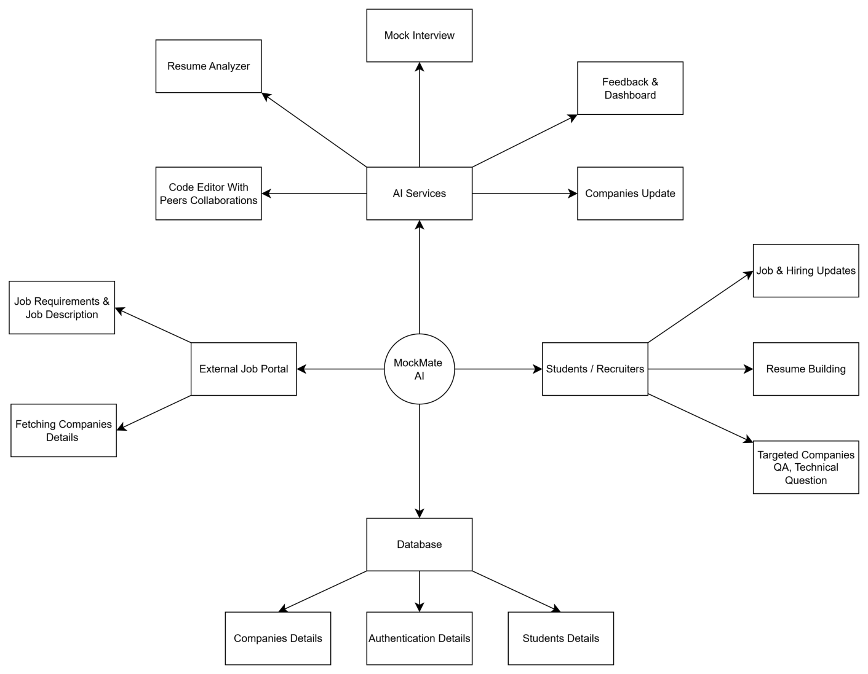
DFD Level 1

Slide 22
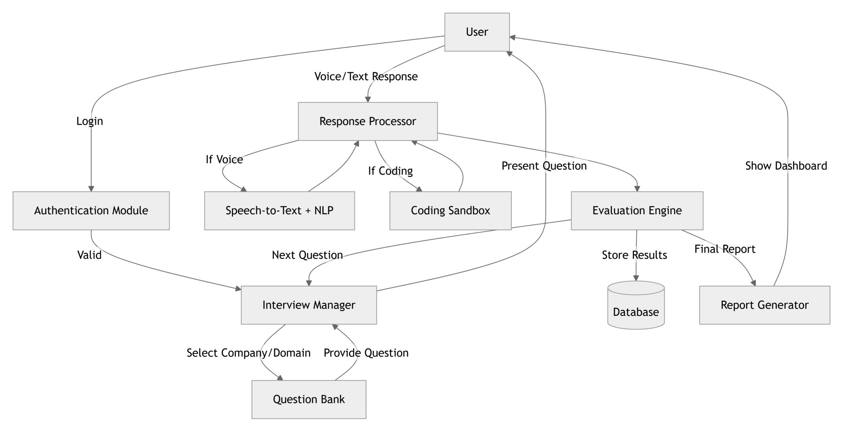
DFD Level 2

Slide 23
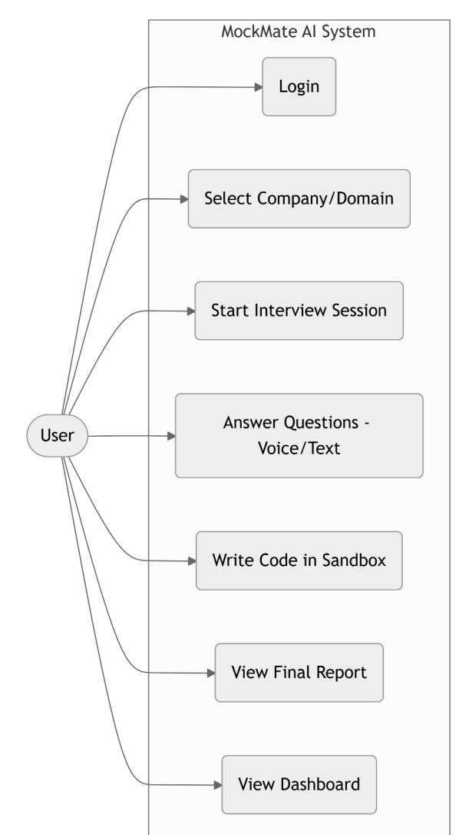
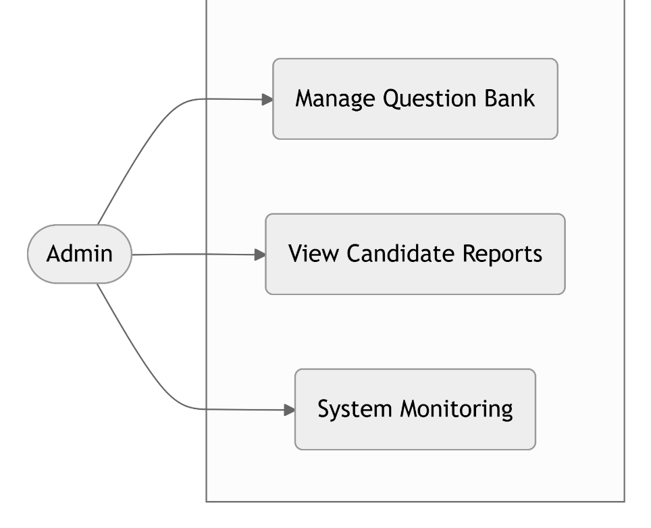
UML Digrams

Slide 24
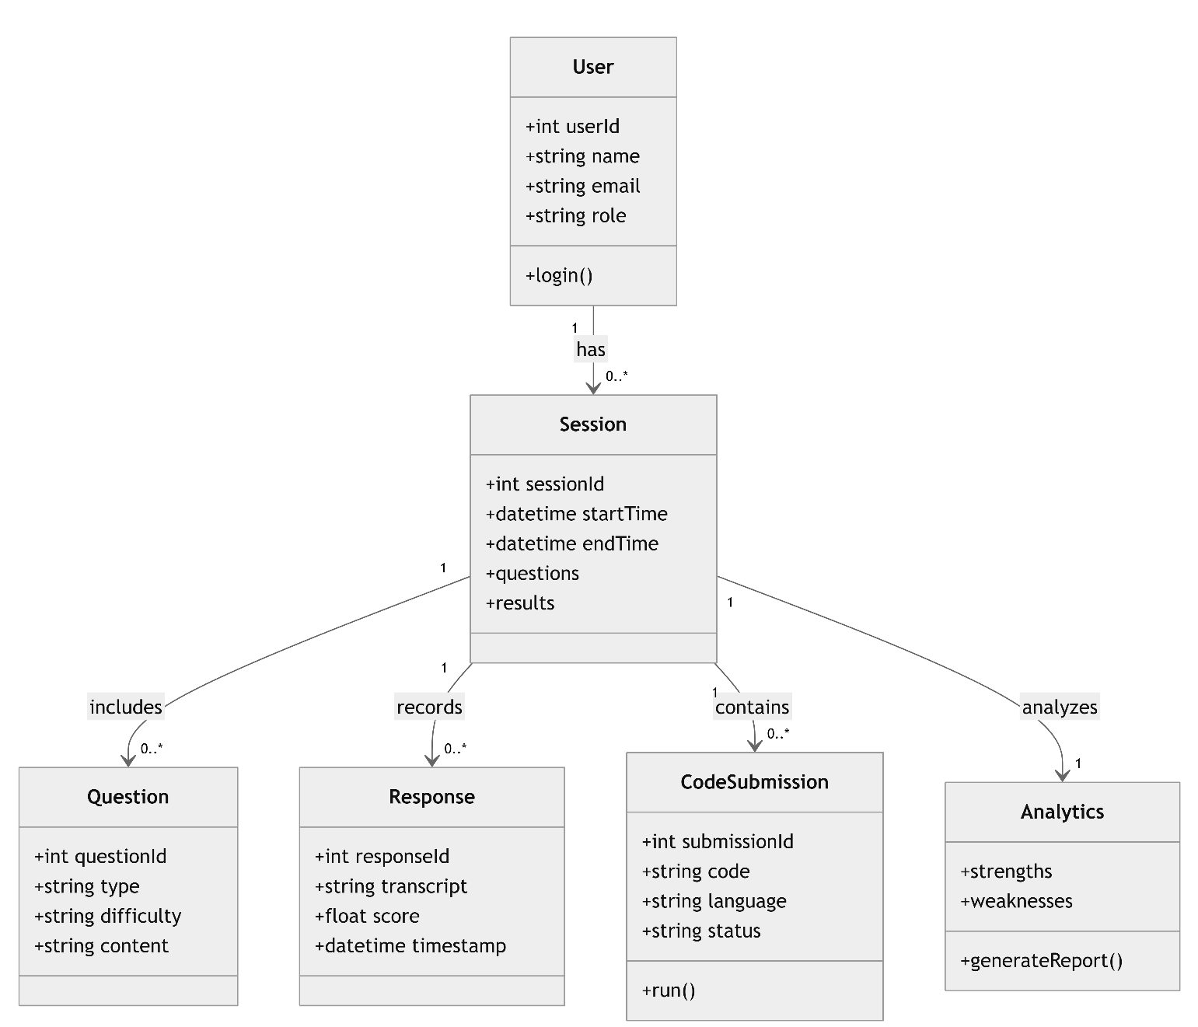
Class Digrams

Slide 25
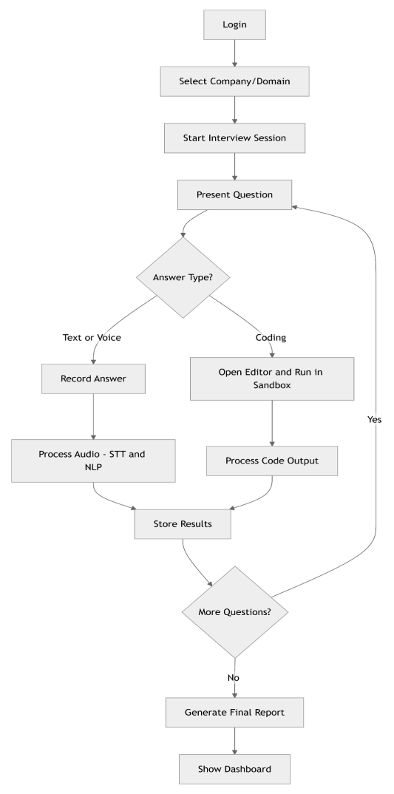
Activity Digrams

Slide 26
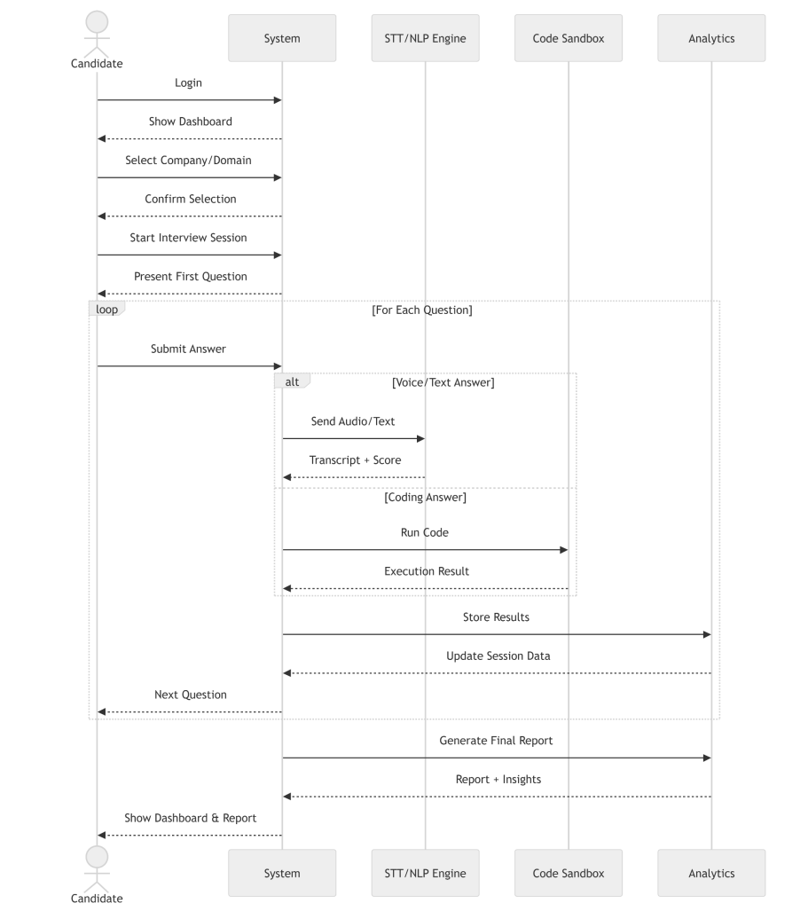
Sequence Digrams

Slide 27
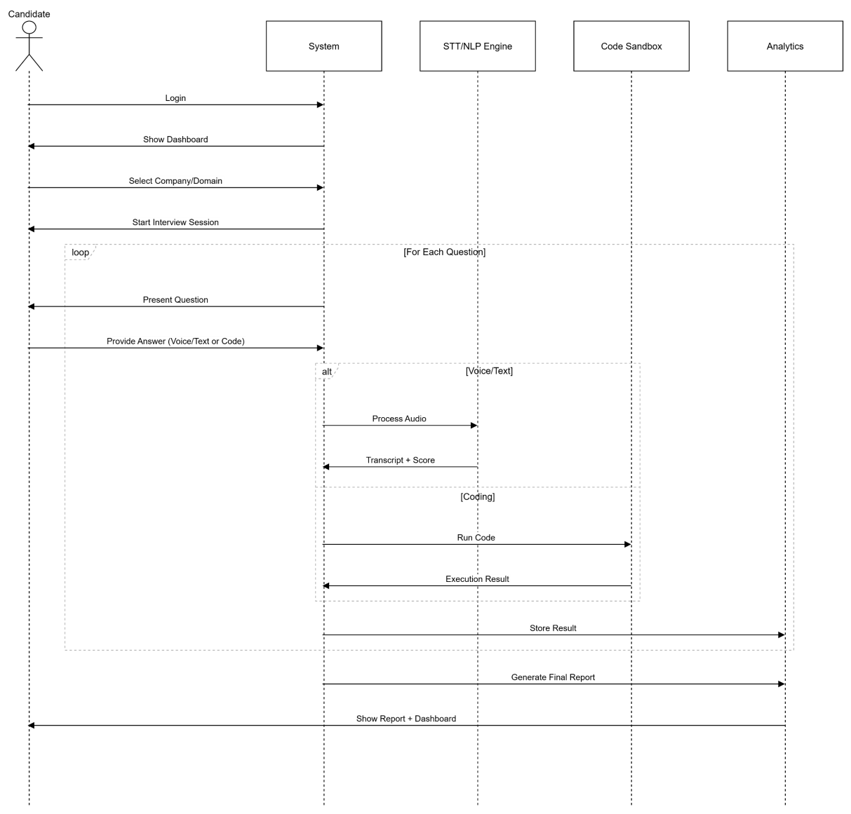
Use Case Digrams

Slide 28
Softwares Used
Frontend: HTML, CSS, JavaScript (React or Plain JS)
Backend: Node.js (Express) / Python (Flask or Django)
Database: MongoDB / Firebase
AI Tools: Google Gemini API
Code Editor: Visual Studio Code
Authentication: Firebase Auth / OAuth
Deployment: Vercel / Render
Hardware: No Hardware Required

Slide 29
Future Work
Integration of Advanced AI Models – Incorporate more powerful LLMs and multimodal AI for deeper analysis of voice, expressions, and coding style.
Gamification & Leaderboards – Add competitive elements like leaderboards, badges and rewards to motivate students.
Mobile Application Development – Extend the platform to Android for on-the-go placement preparation.
Integration with Career Platforms – Connect with LinkedIn, Naukri, or college placement cells to directly showcase student performance and readiness.

Slide 30
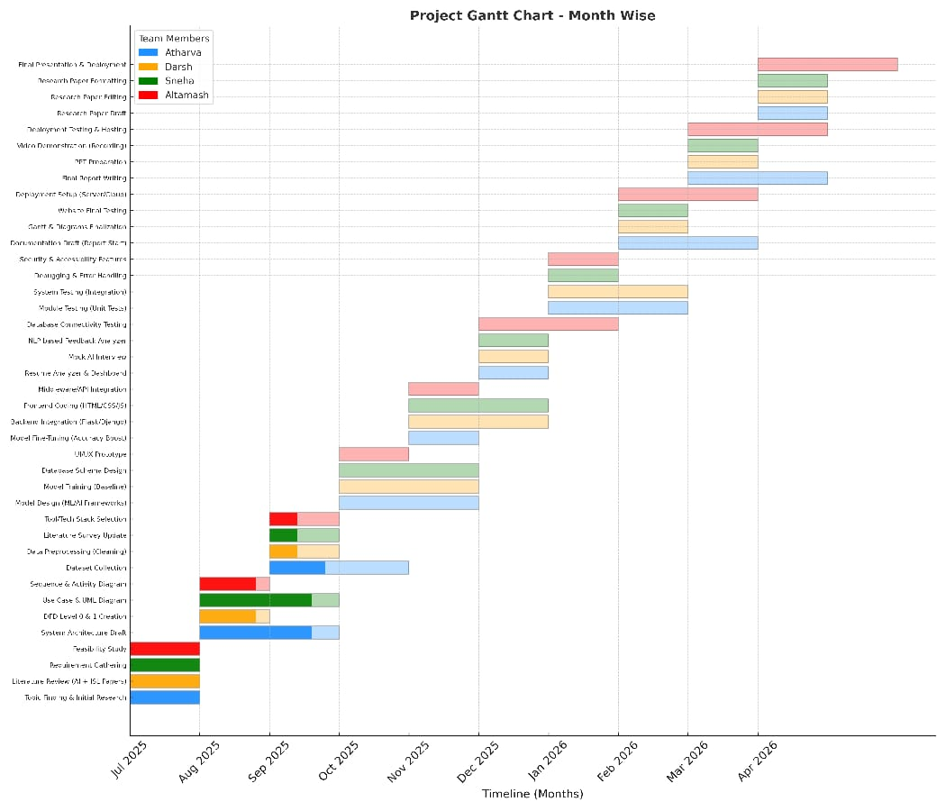
Month Wise Gantt Chart

Slide 31
Week Wise Gantt Chart

Slide 32
References
[1] L. Jagtap, S. Rane, R. Dhonnar, J. Pawar, and U. Bhadane, “AI-Based Interview Mocker System,” (IJARSCT), 2025.
[2] F. Nagasawa, S. Okada, K. Nitta, and T. Ishihara, “Adaptive Interview Strategy for Robots,” IEEE, 2024.
[3] C. Kim, W. Lee, J. Choi, D. Yoo, and J. Yoon, “Fairness-Aware Multimodal Learning,” IEEE, 2023.
[4] H.-Y. Suen, K. Hung, and C.-L. Lin, “TensorFlow-Based Automatic Personality Recognition,” IEEE, 2019.

Slide 33
Thank You

